Slide 1
Intro Dataviz
With Python

Slide 2
Data Visualization Concepts
What chart should I use?
Depends on the data type
What concept you are trying to convey

Slide 3
Data Types
Numerical (temperature,weight,height)
Categorical (color, big, small, pokemon type)
Ordinal (education level grade school, middle, high school, bachelors, masters,PhD)

Slide 4
4 Basic Charts
Bar Chart (Comparison)
Scatter Plot (Relationship)
Line Chart (Trends of time)
Box Chart (Distribution)

Slide 5
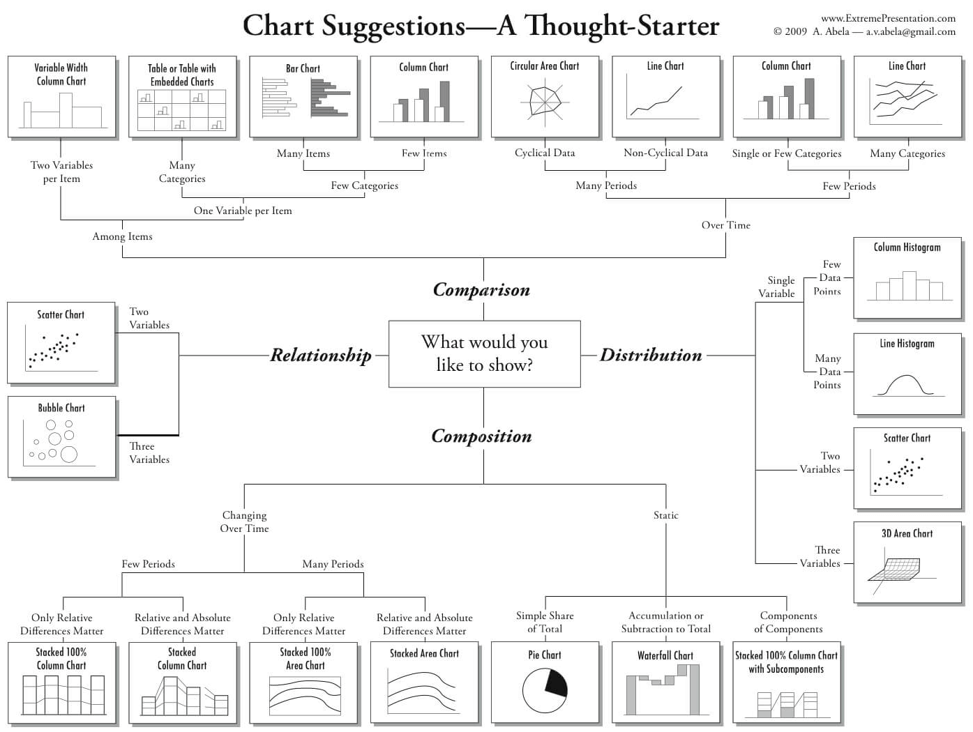
Notes:
https://eazybi.com/blog/data-visualization-and-chart-types
https://www.linkedin.com/pulse/choosing-right-chart-type-data-visualization-strategy-suneel-patel/

Slide 6
Grammar of Graphics
the data,
the aesthetic mapping of the variables in the data to visual cues, and
the geometry used to encode the observations on the plot.
Facets, statistics, coordinates, theme
Notes:
Introduces 90s by Dr. Leland Wilkson
A common Language for thinking about making graphs

